Slide 1

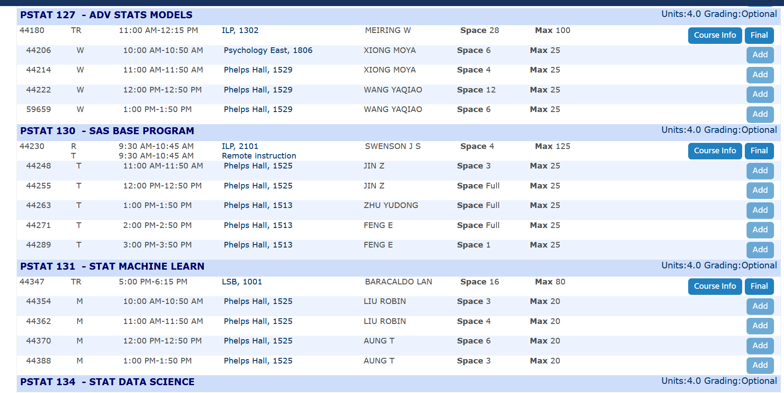
Course Recommendation
System
Jiaxin Su
03/20/2026

Slide 2
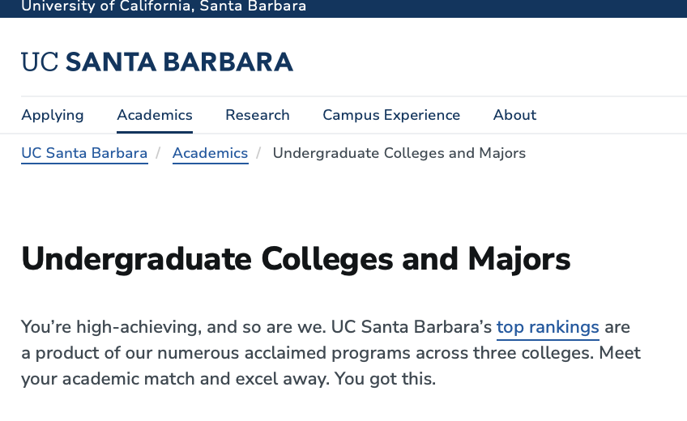
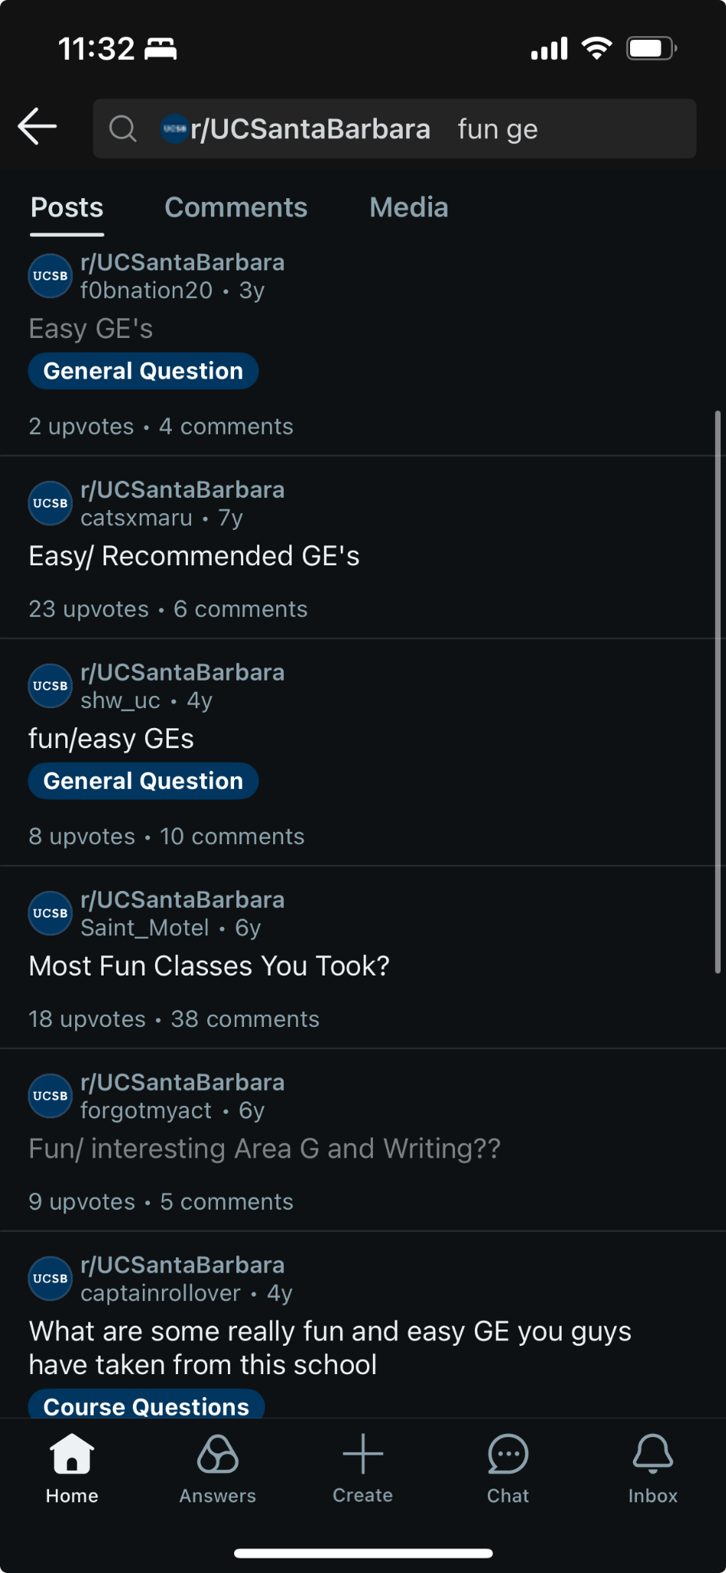
UCSB offers a liberal arts education
Vast variety to courses in different subjects.
No official way for students to get tailored list of courses that match their interest outside of their major.
besides friends or Reddit
Goal: Help with course searching by creating a course recommendation system that recommend UCSB courses to students based on their interests. Offer explanation for recommended courses through LLM
Problem
Notes:
As we know, UCSB offers a liberal arts education in that it offers a variety of courses in multiple different disciplines.
However, with the amount of courses, there is no official way for students to get a tailored made recommendation list outside fo their major. Besides reddit or friends.
That’s why we decided to help with the course search process by implementing a UCSB course recommendation system that recommend UCSB courses to students based on their interests.

Slide 3
The course description dataset and the underlying BM25 retrieval framework were first developed by me about a year ago and later extended for this project.
Contribution: designed the weighted student-profile matching logic, added filtering rules to improve recommendation quality, and incorporated an LLM-based reranking and explanation layer to make final recommendation more interpretable
Existing Work and Contribution
Notes:
My main contribution to this project is extending an earlier BM25-based course recommendation system into a more complete and personalized pipeline. I reused the course description dataset and the core BM25 retrieval framework that I originally built about a year ago, then adapted it to work with a structured student profile dataset. For this version, I designed the weighted student-profile matching logic, added filtering rules to improve recommendation quality, and incorporated an LLM-based reranking and explanation layer to make the final recommendations more personalized and interpretable. I also handled the data preprocessing, prompt design, and integration needed to connect the retrieval stage with the LLM output.

Slide 4
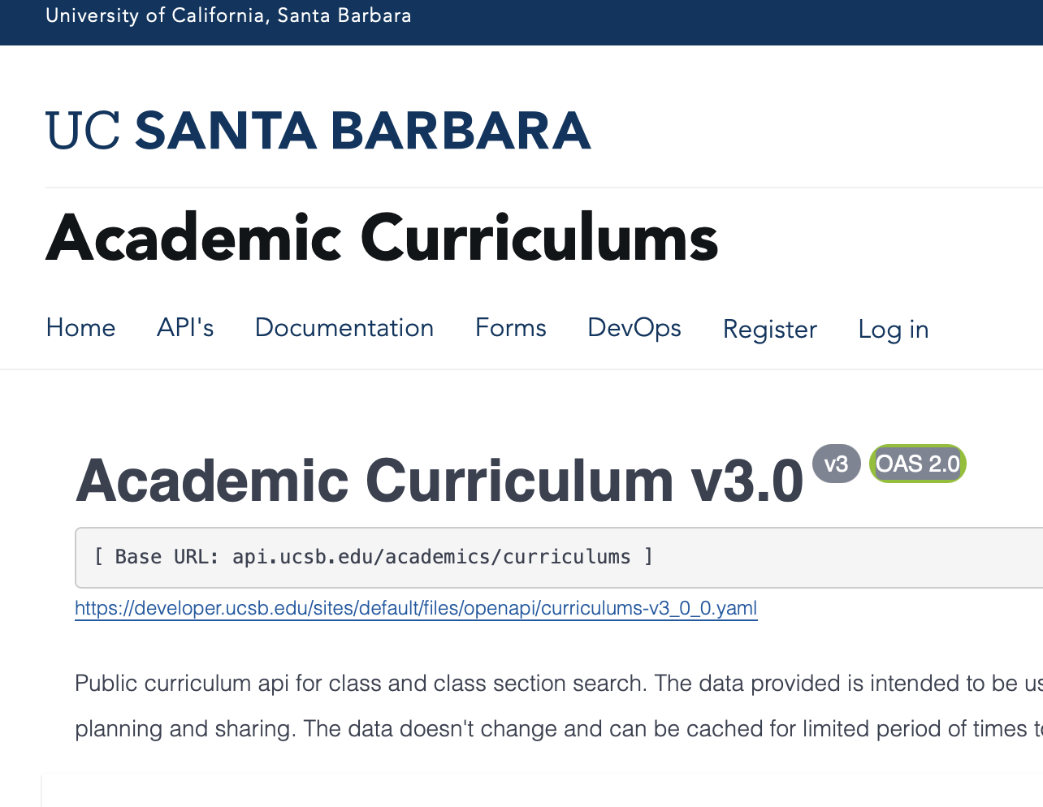
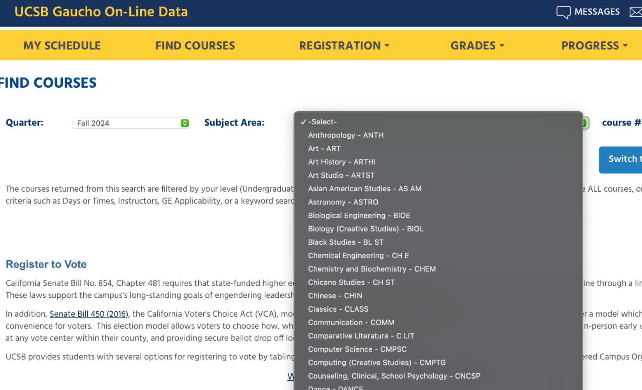
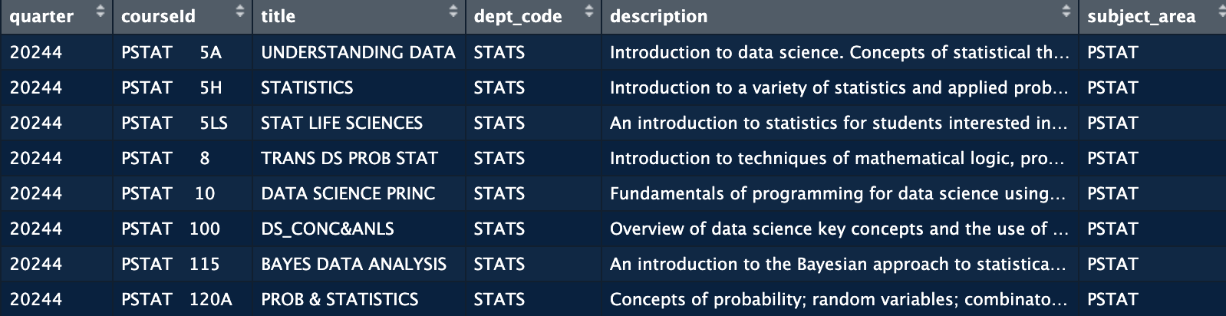
API and Courses Data
Academic Curriculum v3.0 API + key
Example Url: https://api.ucsb.edu/academics/curriculums/v3/classes/search?quarter=20244&subjectCode=PSTAT&pageNumber=1&pageSize=500&includeClassSections=true
Fall 2024 Course Data
the quarter, courseId, title, department code, course description, the subject area, course level, which college, number of units, the instruction type, whether the course is online.
Stored as a large dataframe .csv file.
Notes:
The student data was acquired from a Kaggle dataset. In order to recommend courses to the students in this dataset, courses by subject were extracted from the UCSB API using R. A data frame was constructed with each course having a fraction of the information fields provided by the API. This course dataframe was exported into a csv file that we performed exploratory data analysis on.

Slide 5
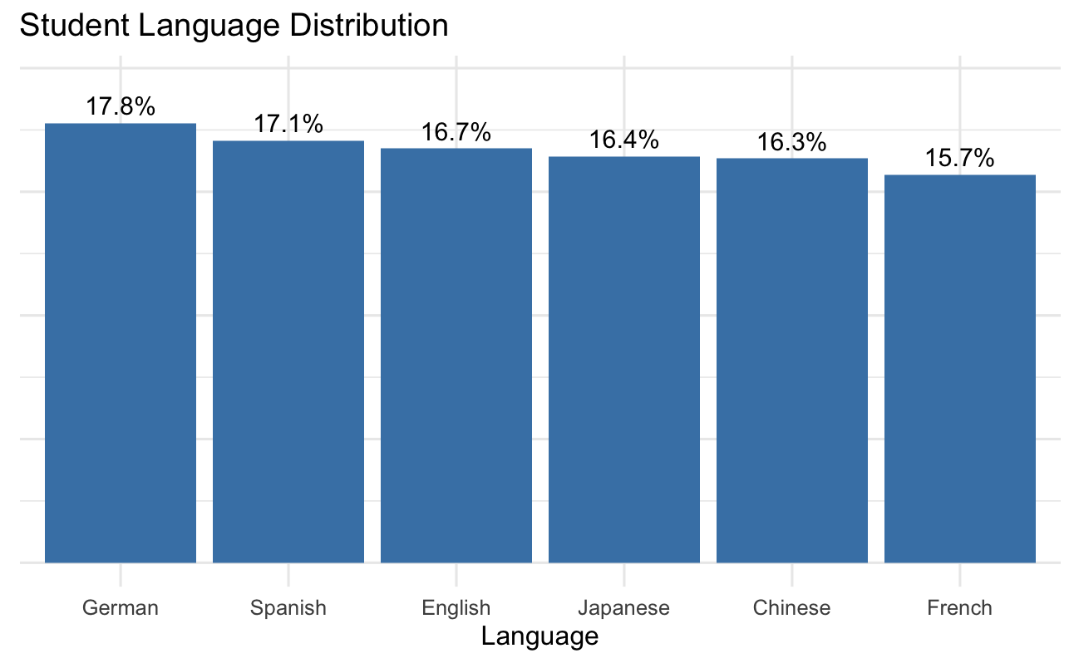
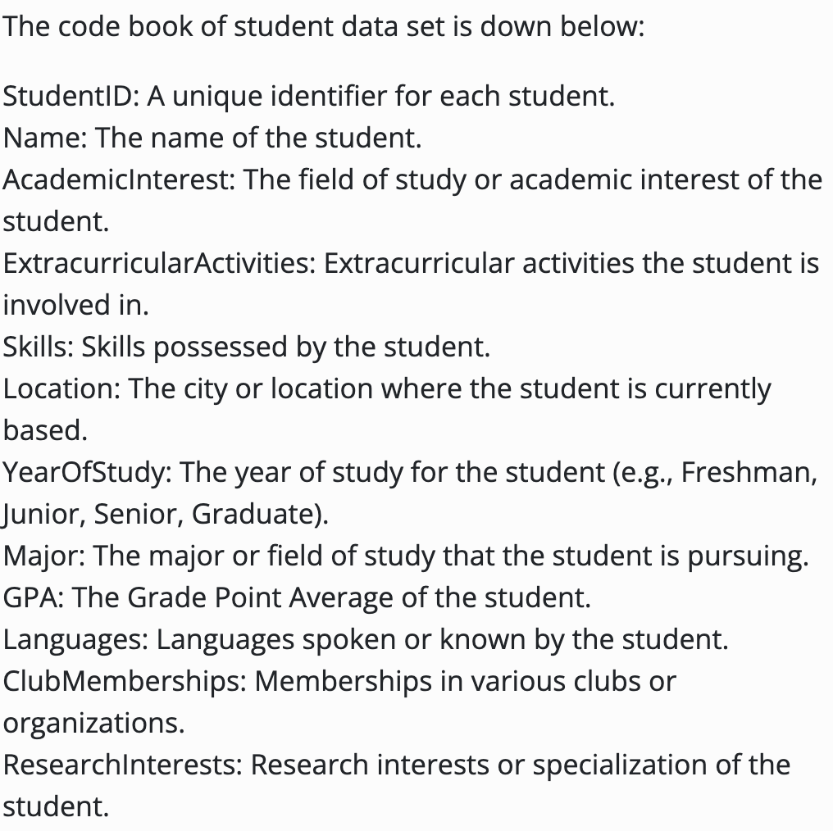
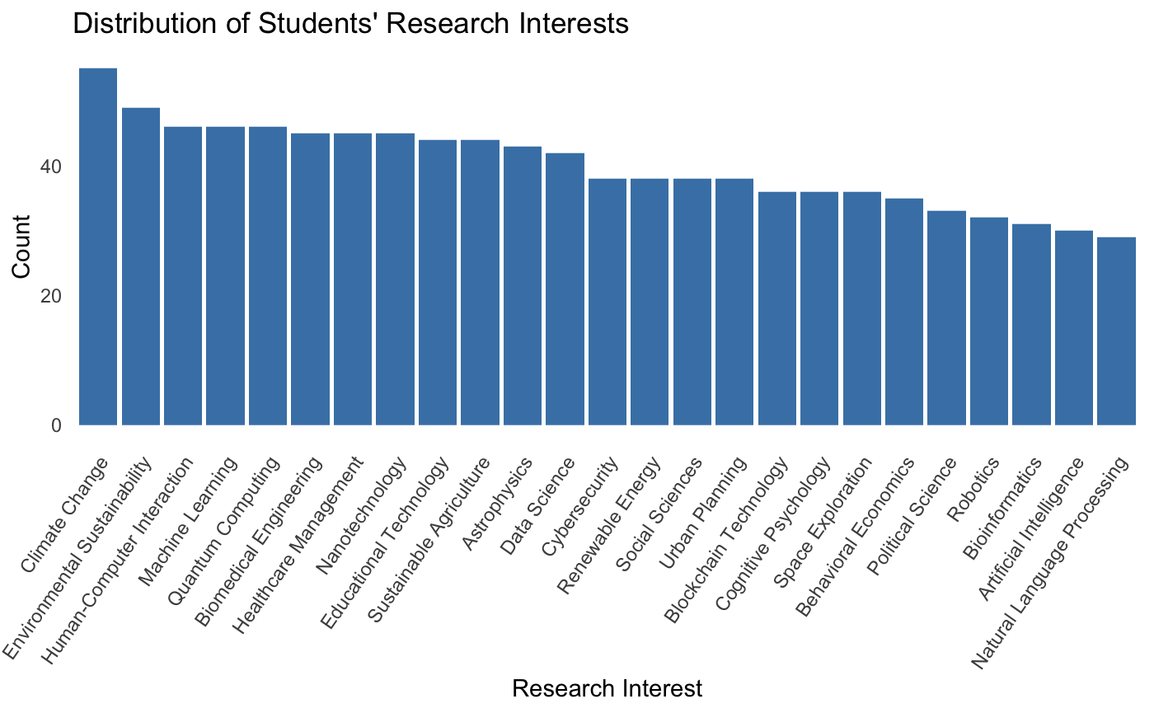
Student Data
Kaggle Dataset: “Student Extracurriculars Info”
Include information about students’ academic interest, major, etc

Slide 6
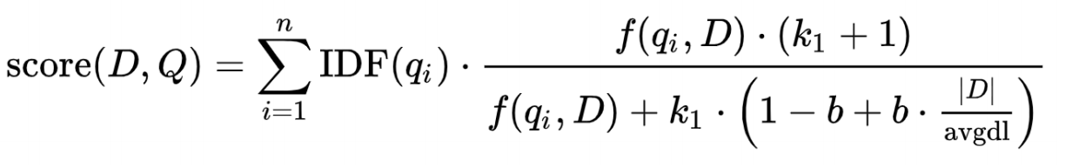
Methodology- Recommender System
Content -based Filtering Methods
No historical data for each student’s course selection behaviors
Recommend based on students’ academic and extracurricular interests, and the course description
Merge Students information into one merged column
academic interest, extracurricular activities, skills, major, club memberships, research interests, and the languages students speak.
Give different weight to each type of students’ interests to give more emphasis on important information
Tokenization of Course Description into Words
Similarity Algorithm – BM25
Recommend the top 5 courses that have the highest BM25 scores
Notes:
- How we built the recommender system
The recommendation system uses the BM25 algorithm. This algorithm takes idf scores for each token in the course descriptions. The query term in our case is each token in the students’ profile text. The document here is each course description. The larger the output similarity scores are, the similar a given course is to a given student’s interests.

Slide 7
Student profile → BM25 retrieves top 5–10 courses → LLM reranks candidates → Top 3 final recommendations + explanations
LLM Reranking and Explanation Layer
Notes:
Why add an LLM?
BM25 is effective for keyword-based retrieval
But it may miss broader context across student interests, skills, and research goals
The LLM helps refine the shortlist using higher-level reasoning
What the LLM does
Takes the student profile and top BM25 candidate courses as input
Selects the best final recommendations
Generates short personalized explanations for each course

Slide 8
Example
Student Profile
Student: Student 960
Major: Biology
Year: Senior
Academic Interest: Physics
Research Interest: Sustainable Agriculture
Skills / Activities: Leadership, Art Club
Top 3 Final Recommendations
ESM 224 – Sustainable Water Resource Management
BM25 Score: 26.59
Why selected: Strong match to the student’s sustainability-related research interests.
EEMB 188RE – Conservation Restoration Seminar
BM25 Score: 24.76
Why selected: Aligns with the student’s biology background and environmental interests.
ME 154 – Structures
BM25 Score: 27.61
Why selected: Retrieved as a relevant candidate, though less directly aligned than the top two.

Slide 9
Weighted student profile fields: Different parts of the student profile were not equally informative, so I assigned higher weights to academic interests, major, and research interests, while keeping extracurriculars, skills, clubs, and languages as lower-weight signals.
Course ID formatting mismatch: The LLM sometimes returned course IDs with spacing that did not exactly match the original dataset, so I added normalization rules to merge the reranked output back to the course table correctly. Over-recommendation of special study courses: Courses like 99 and 199 kept appearing across many students, so I introduced filtering rules to remove independent study / research-placement style courses from the candidate pool. API integration and authentication issues: Connecting the reranking stage to an OpenAI-compatible provider required debugging environment variables, authentication setup, and model configuration before the LLM pipeline ran reliably.
Issues Overcome along the way

